Slide 1
Sweeping lines
Prepared by,
Dr.S.Jenicka

Slide 2
Right horizontal ray
Given a point p₀ =(x₀, y₀) the right horizontal ray from p₀ is the set of points {p_{i} = (x_{i}, y_{i} )/ x_{i} ≥ x₀ and y_{i} = y₀, that is, it is the set of points due right of p₀ along with p₀ itself.

Slide 3
Determining whether any pair of segments intersects
An algorithm for determining whether any two line segments in a set of segments intersect. The algorithm uses a technique known as “sweeping,” which is common to many computational-geometry algorithms.
In sweeping, an imaginary vertical sweep line passes through the given set of geometric objects, usually from left to right. We treat the spatial dimension that the sweep line moves across, in this case the x-dimension, as a dimension of time. Sweeping provides a method for ordering geometric objects, usually by placing them into a dynamic data structure, and for taking advantage of relationships among them.

Slide 4
To describe and prove correct our algorithm for determining whether any two of n line segments intersect, we shall make two simplifying assumptions.
First, we assume that no input segment is vertical.
Second, we assume that no three input segments intersect at a single point.

Slide 5
The line-segment-intersection algorithm in this section
considers all the line-segment endpoints in left-to-right order and
checks for an intersection each time it encounters an endpoint.

Slide 6
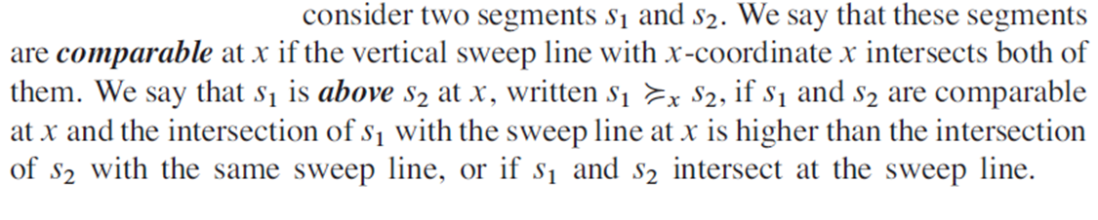
Ordering segments

Slide 7
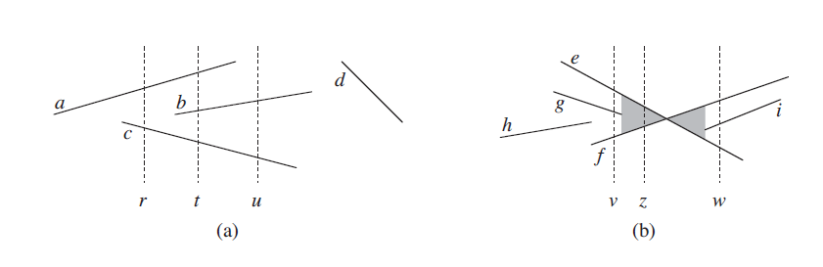
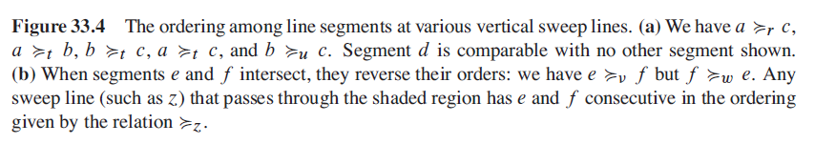

Slide 8
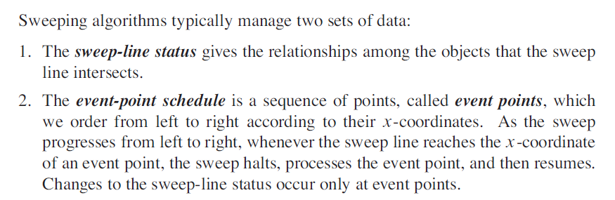
Moving the sweep line
1.Event point schedule: First we will sort all endpoints of line segments as event points and store in a list.
2. Sweep line status: As the sweep line passes through the line segments we will order/ reorder the line segments based on the current status and store in a dynamic data structure such as a balanced binary search tree (which takes log n time for search, insertion and deletion of a node) so as to detect if any 2 line segments intersect or not.

Slide 9
In particular, each segment endpoint is an event point.
We sort the segment endpoints by increasing x-coordinate and proceed from left to right. If two or more endpoints are covertical, i.e., they have the same x-coordinate, we break the tie by putting all the covertical left endpoints before the covertical right endpoints.
Within a set of covertical left endpoints, we put those with lower y-coordinates first, and we do the same within a set of covertical right endpoints.
When we encounter a segment’s left endpoint, we insert the segment into the sweep-line status, and we delete the segment from the sweep-line status upon encountering its right endpoint.
Whenever two segments first become consecutive in the total preorder, we check whether they intersect.

Slide 10
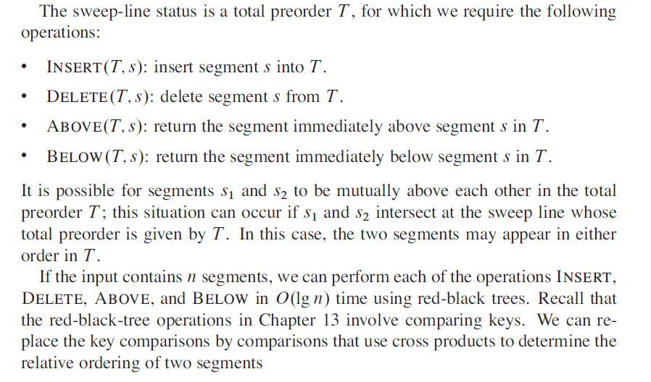

Slide 11
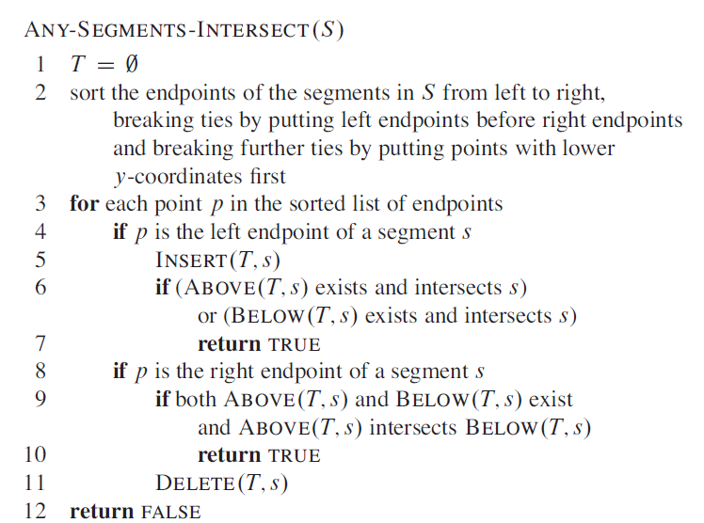

Slide 12
